Slide 1

`
CONST OF A TYPE HOUSES 36 A & B CKL GAR

Slide 2
INDEX
Ser | Description | Page No
1 | Proj Salient | 3
2 | Aerial View | 4
3 | A Type House
 | a. Line Plan – House | 5
 | b. Line Plan – Annexe & Adm Area | 6
 | d. Exterior View | 7
 | e. Photos | 8-17
4 | Annexe
 | a. Exterior View | 18
 | b. Photos | 19-22
5 | Adm Area
 | a. Exterior View | 23
 | b. Photos | 24

Slide 3
PROJ SALIENT
Name of Proj - Const of 2 x A Type Houses in Ckl Gar
Proj Cost - Rs 262 Mn
Commencement - 15 Jul 2023
Completion - 11 Jul 2024
Scope
2 x A Type Houses
2 x Annexes
2 x Adm Areas
External Svcs
Horticulture
Addl Scope
Designer Room
Gym
Conversion of Guest Room to Mosque
Instl of 100 KVA Gen Set in each house
Provn of 20 KVA Solar Sys in each house
Instl of Louvers on top of bdry wall and Adm Area gate
Elec & Water Sup works

Slide 4
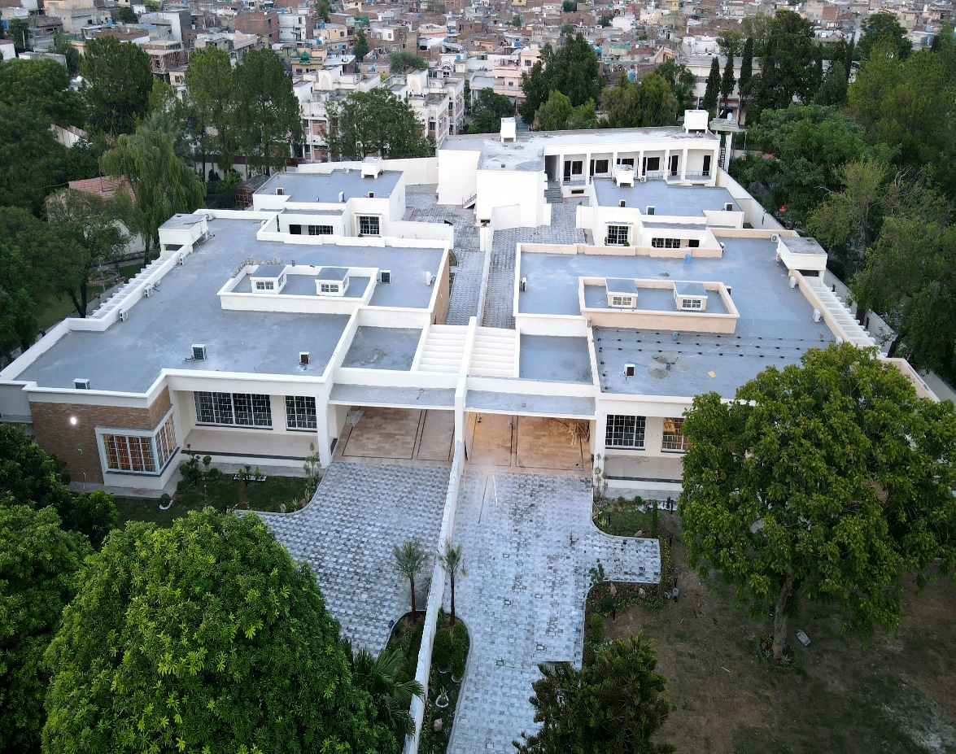
AERIAL VIEW
Adm Area
Annexe
Annexe
House
36 B
House
36 A

Slide 5
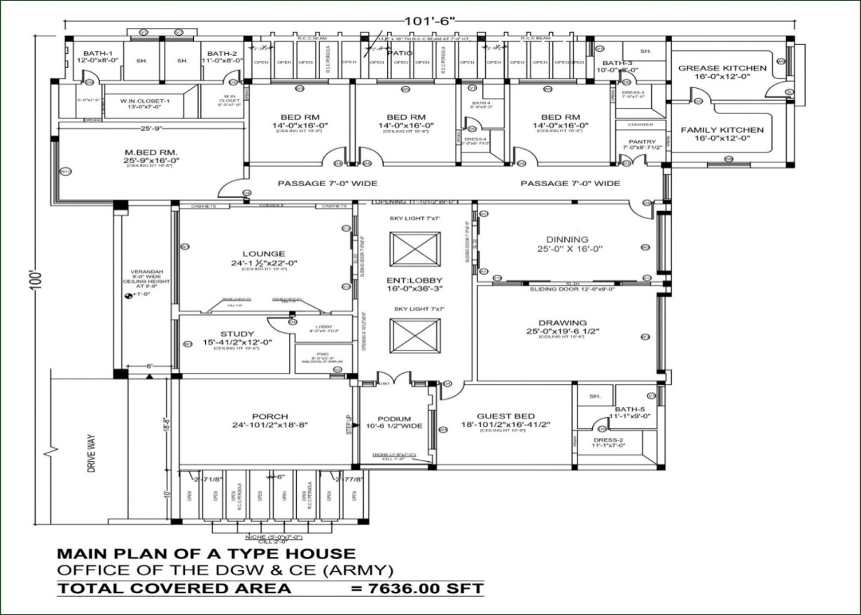
LINE PLAN – A TYPE HOUSE

Slide 6
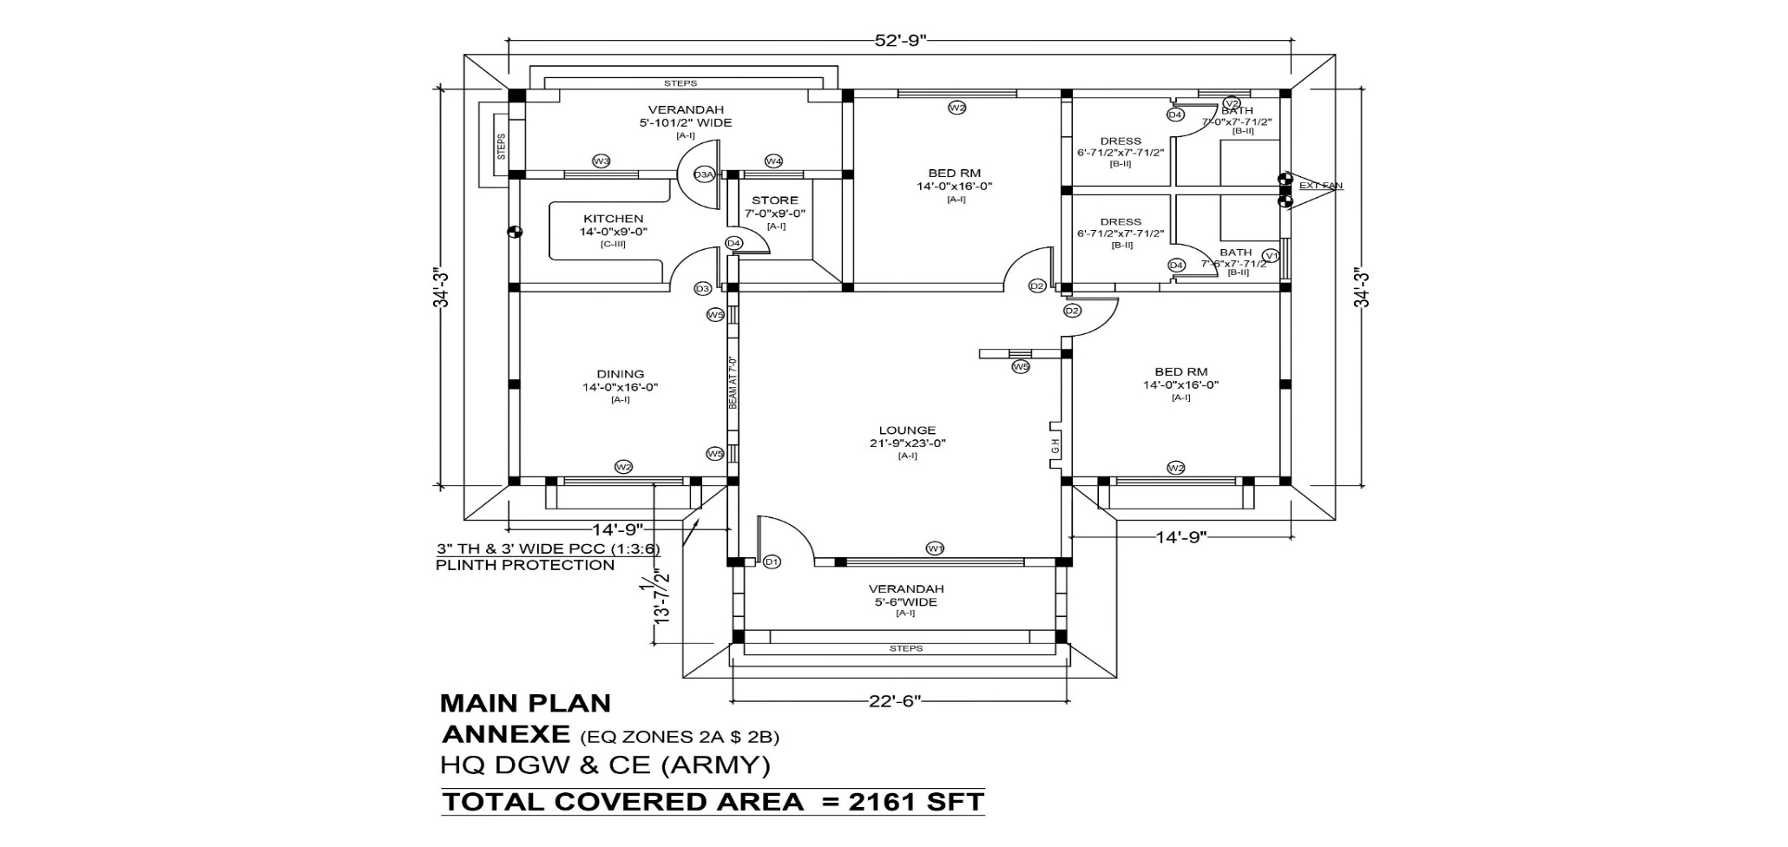
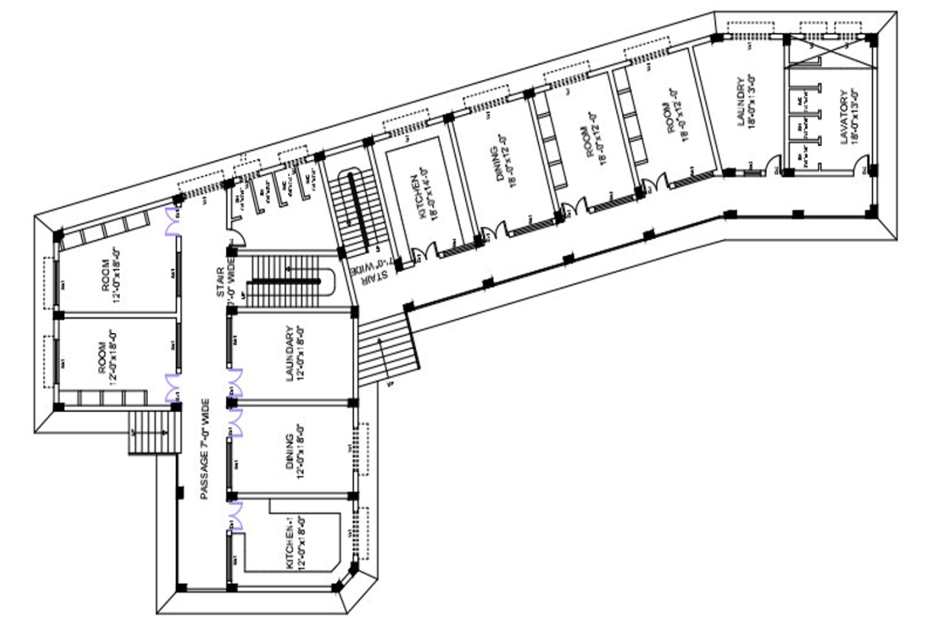
LINE PLAN – ANNEXE & ADM AREA
32 x Men Adm Area

Slide 7
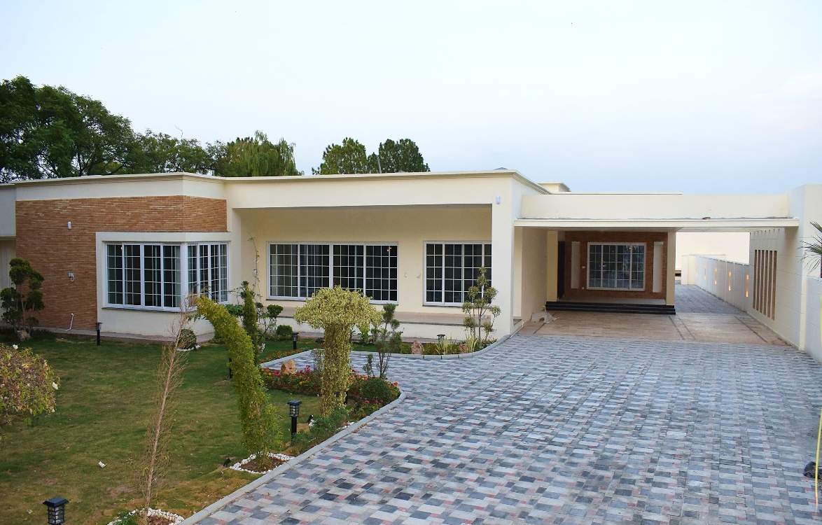
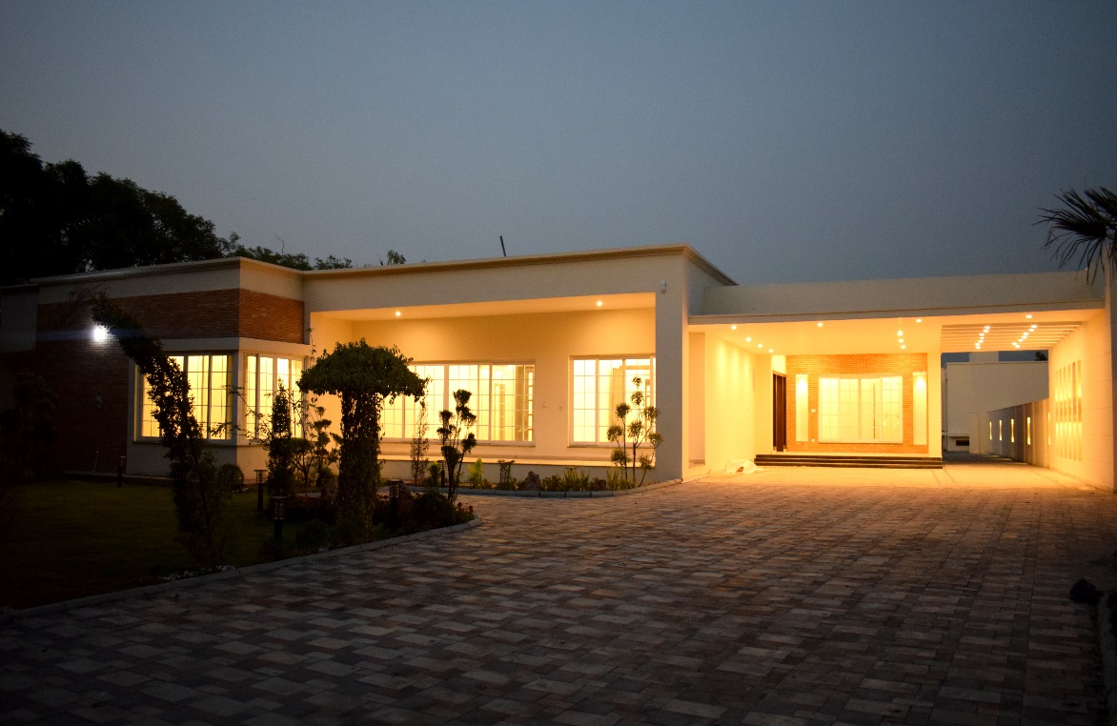
EXTERIOR VIEW

Slide 8
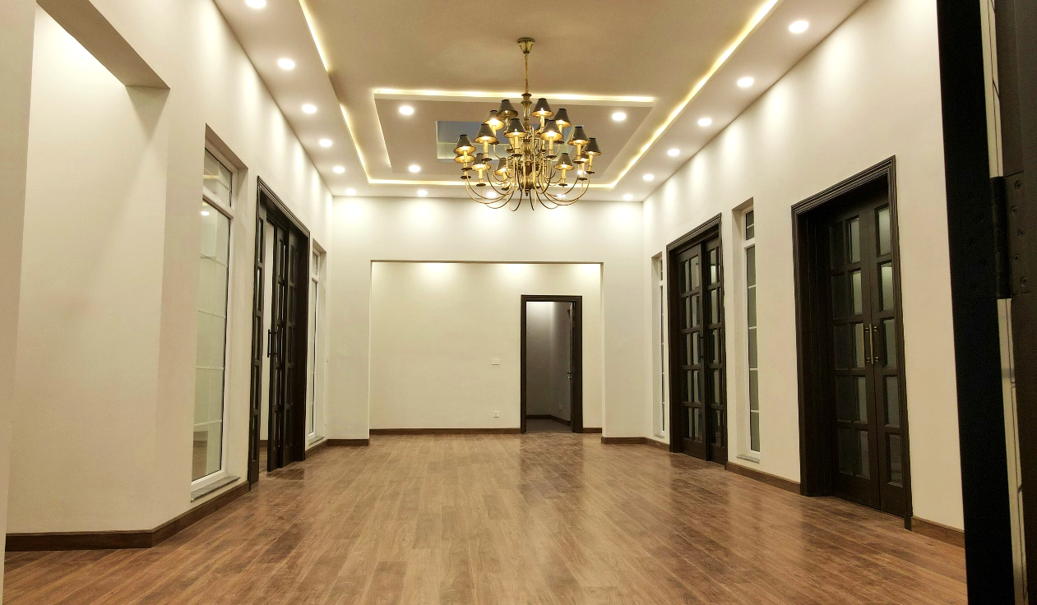
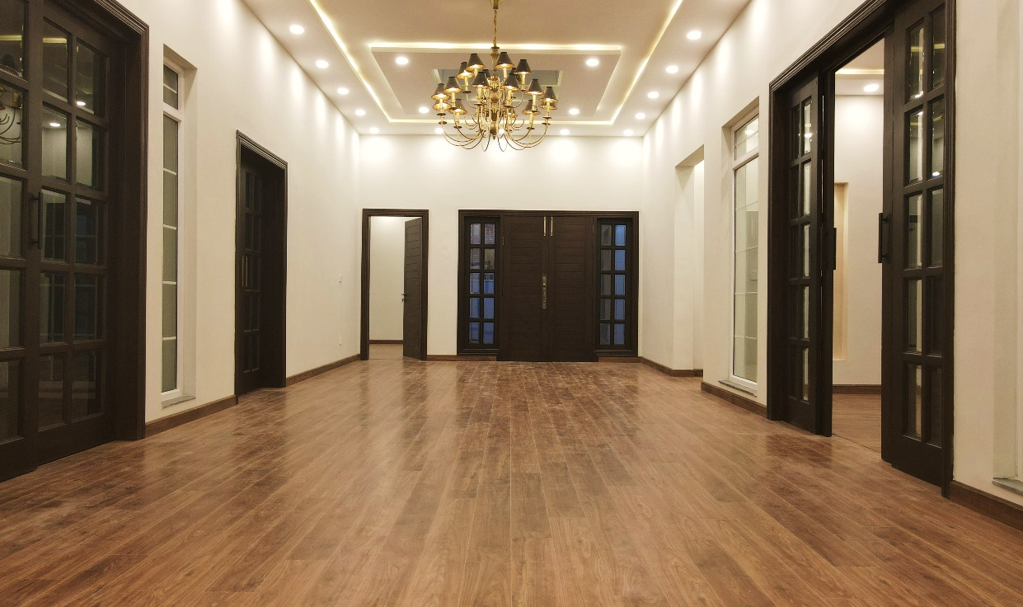
ENTRANCE LOBBY
Specifications
Size | 16’ x 36’-3”
Door | Solid Wooden / Glazed
Floor | Oriel Tiles / Wooden Flooring
Windows | uPVC Wintech
Elec | LED Lts, Rope Lt, Chandelier

Slide 9
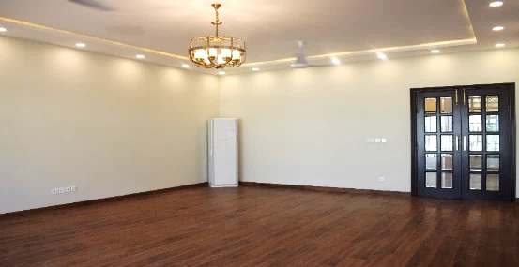
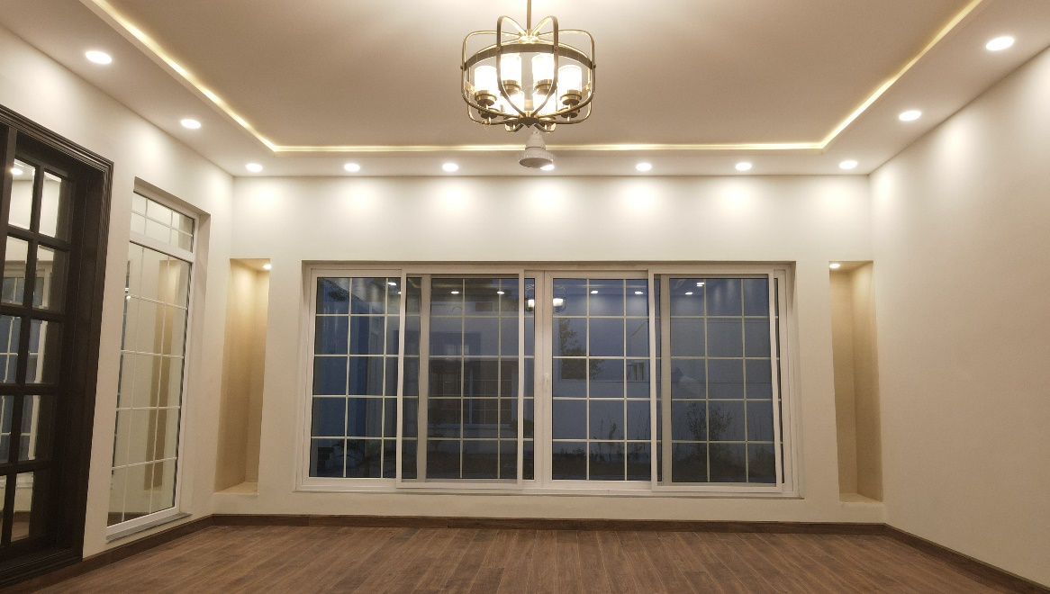
DRAWING ROOM
Specifications
Size | 25’ x 19’-6”
Door | Solid Wooden
Window | UPVC With Tempered Glass
Floor | Oriel Tiles / wooden
Cupboards | Imported Sheets
Ceiling | POP
Elec | Gree AC, Lhr Fan, Philips LED Lts, Chandelier

Slide 10
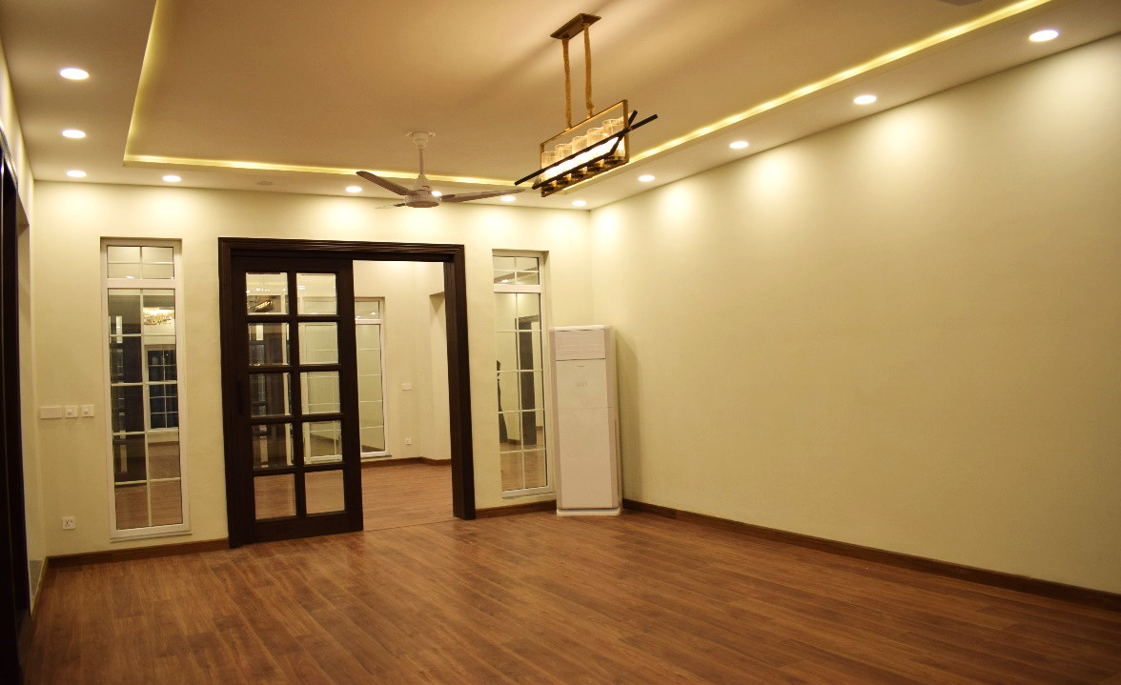
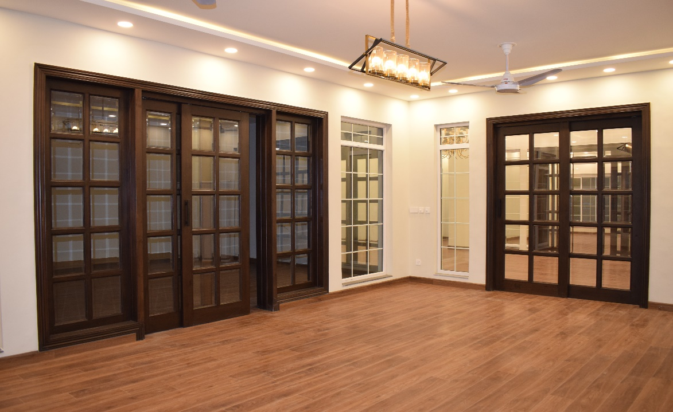
DINNING ROOM
Specifications
Size | 25’ x 16’
Door | Solid Wooden
Window | UPVC With Tempered Glass
Floor | Oriel Tiles / wooden
Ceiling | POP
Elec | Gree AC, Lhr Fan, Philips LED Lts, Chandelier

Slide 11
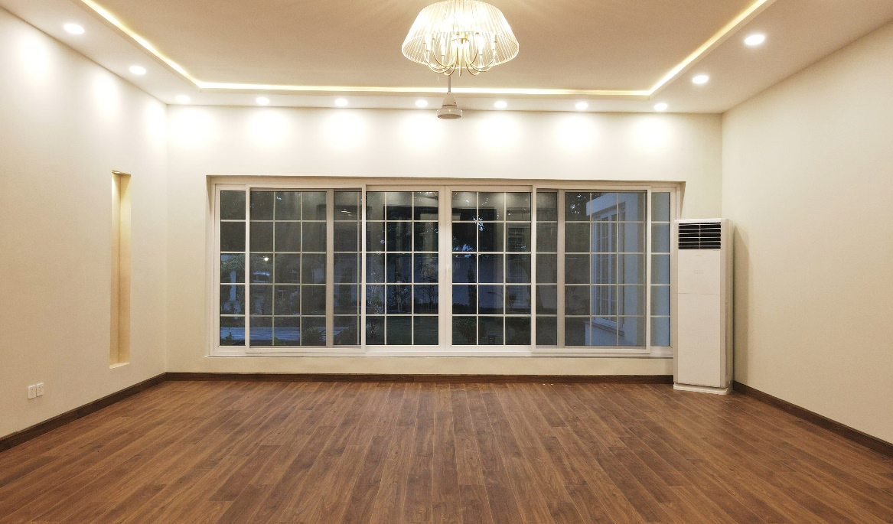
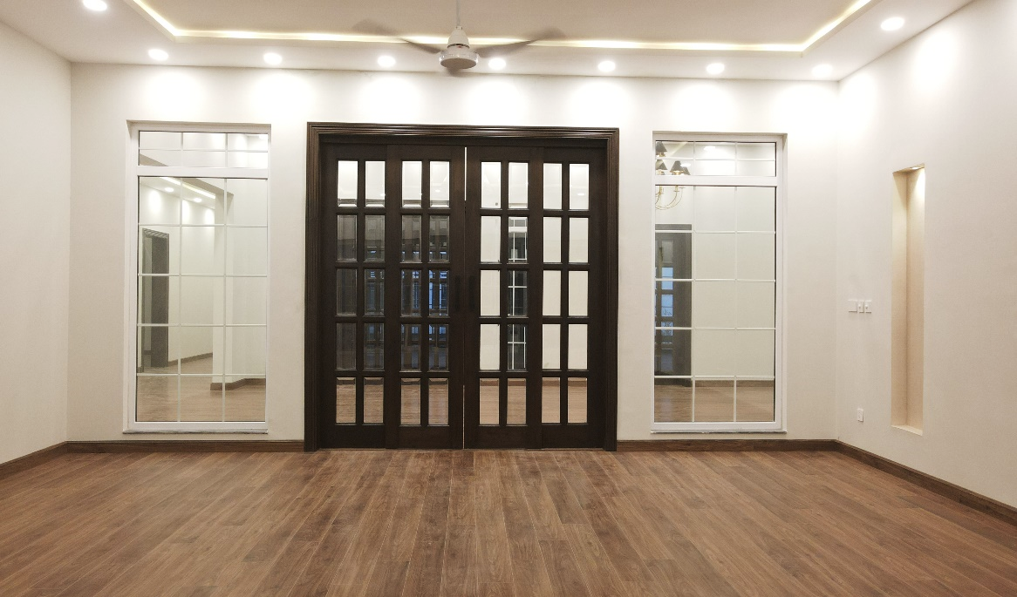
LOUNGE
Specifications
Size | 24’ x 22’
Door | Solid Wooden
Window | UPVC With Tempered Glass
Floor | Oriel Tiles / wooden
Ceiling | POP
Elec | Gree AC, Lhr Fans, Philips LED Lts, Chandelier

Slide 12
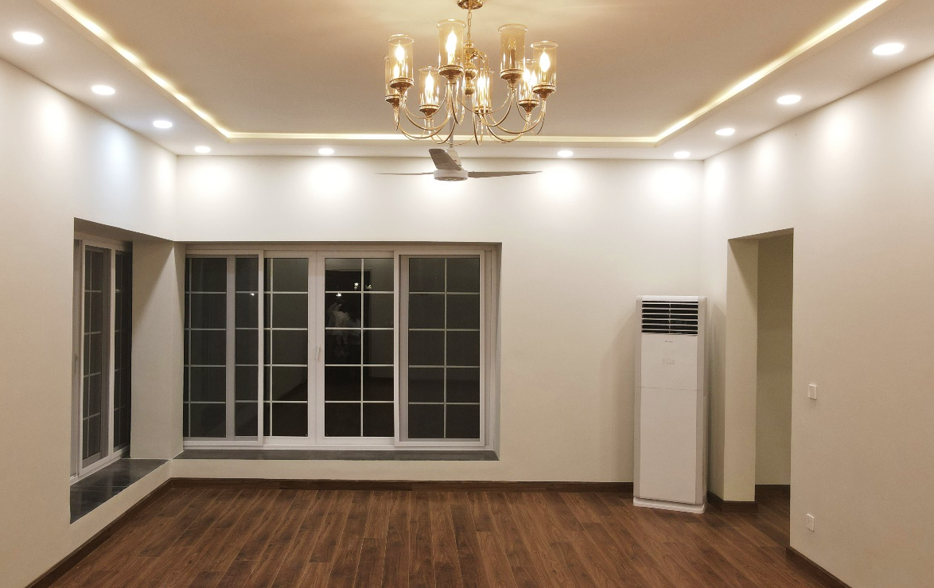
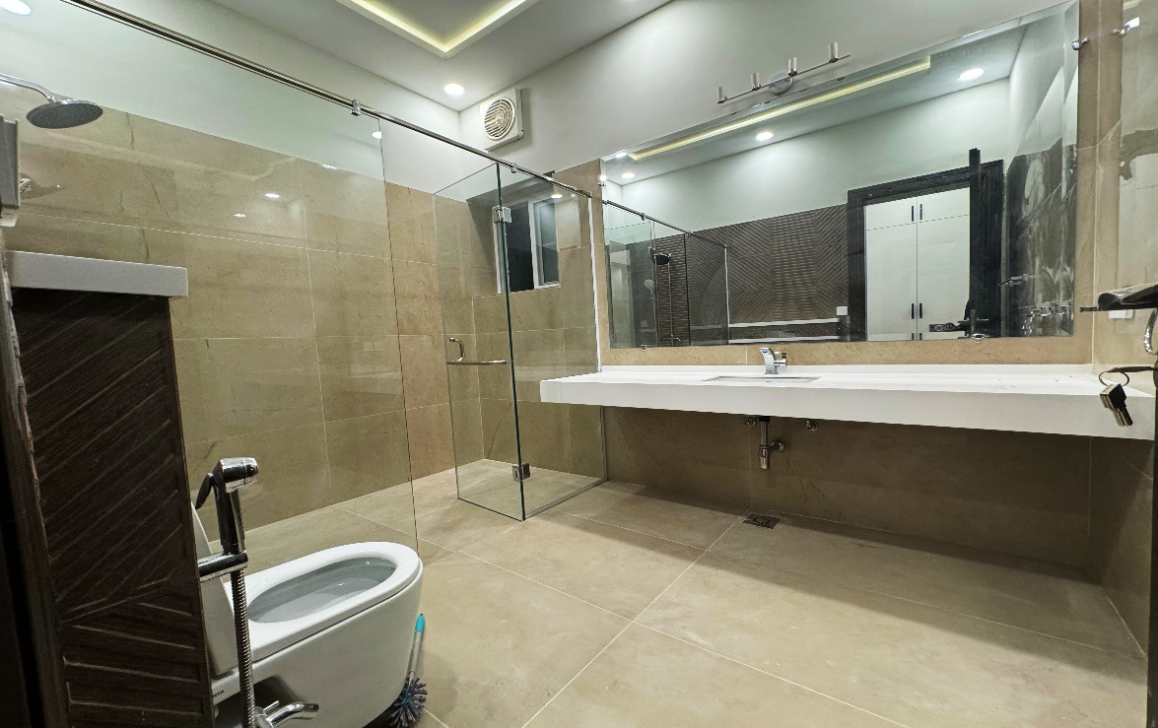
MASTER BEDROOM
Specifications
Size | 25-9’’ x 16’
Door | Solid Wooden
Window | UPVC with Tempered Glass
Floor | Oriel Tiles / wooden
Cupboards | Imported Sheets
Ceiling | POP
Elec | Gree AC, Lhr Fans, Philips LED Lts, Chandelier

Slide 13
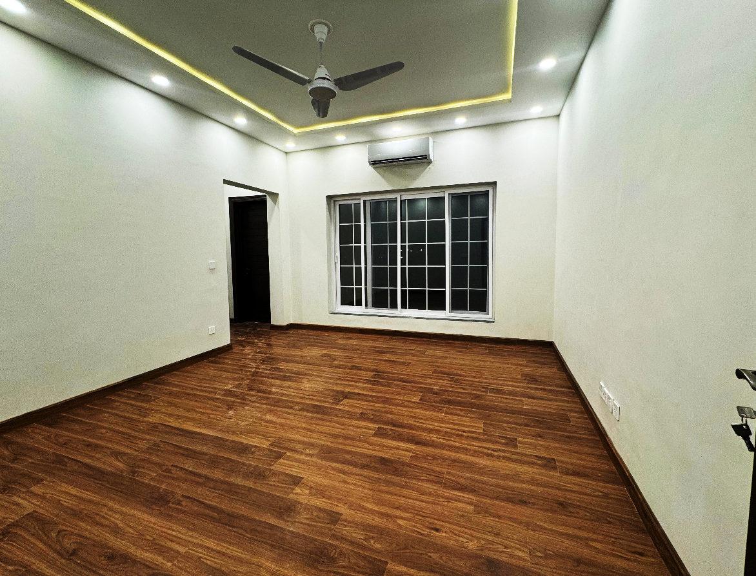
BEDROOM - 1
Specifications
Size | 14’ x 16’
Door | Solid Wooden
Window | UPVC With Tempered Glass
Floor | Oriel Tiles / wooden
Cupboards | Imported Sheets
Ceiling | POP
Elec | Gree AC, Lhr Fans, Philips LED Lts

Slide 14
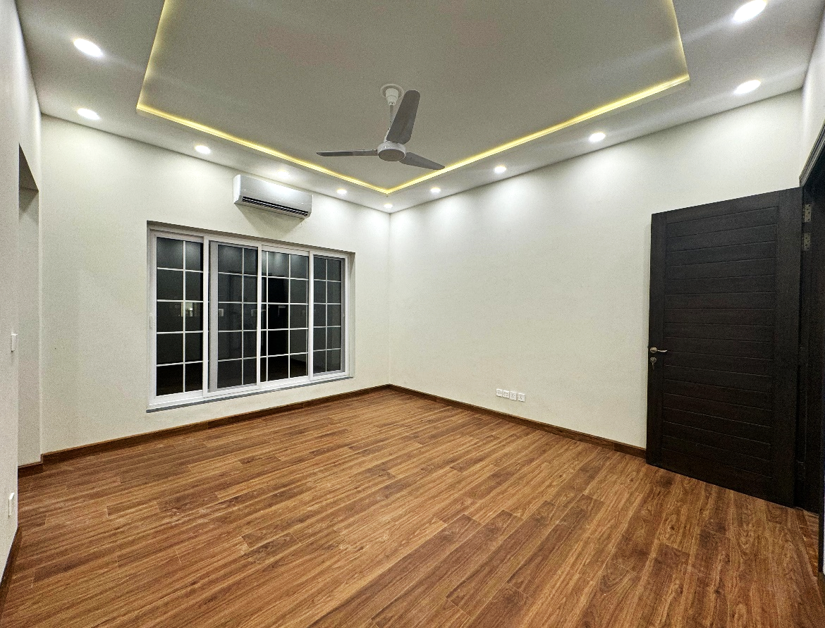
BEDROOM - 2
Specifications
Size | 14’ x 16’
Door | Solid Wooden
Window | UPVC With Tempered Glass
Floor | Oriel Tiles / wooden
Cupboards | Imported Sheets
Ceiling | POP
Elec | Gree AC, Lhr Fans, Philips LED Lts

Slide 15
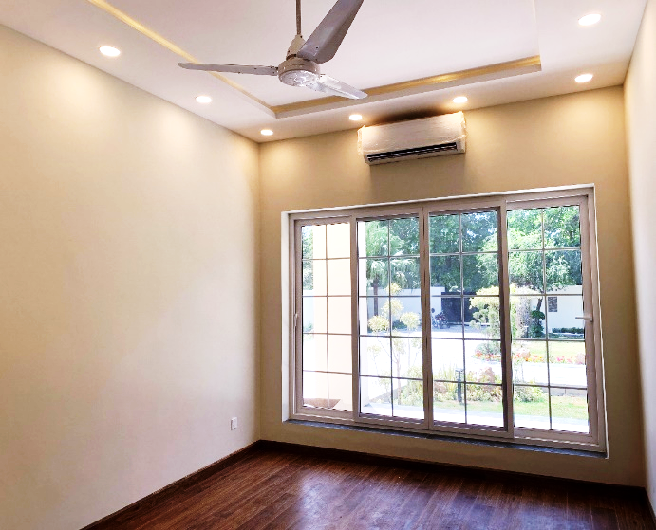
STUDY
Specifications
Size | 15’-4.5” x 12’
Door | Solid Wooden
Window | UPVC With Tempered Glass
Floor | Oriel Tiles / Wooden
Ceiling | POP
Elec | Gree AC, Lhr Fans, Philips LED Lts

Slide 16
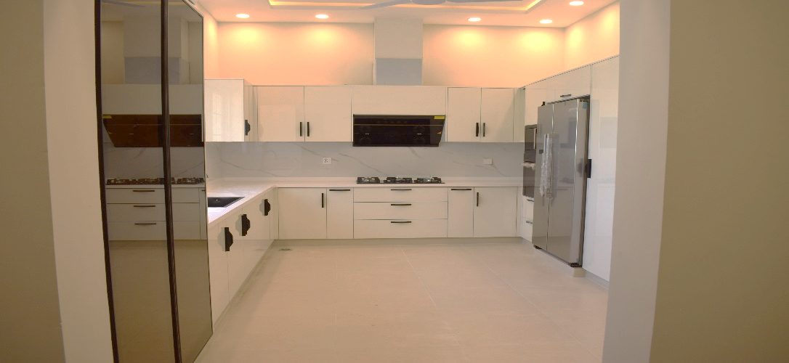
FAMILY KITCHEN
Specifications
Size | 16’ x 12’
Door | Solid Wooden
Window | UPVC With Tempered Glass
Floor | Oriel Tiles
Kitchen Appliances | Fotile
Kitchen Cabinet | Imported Sheets
Refrigerator | Bosch
Sink | Sigplus

Slide 17
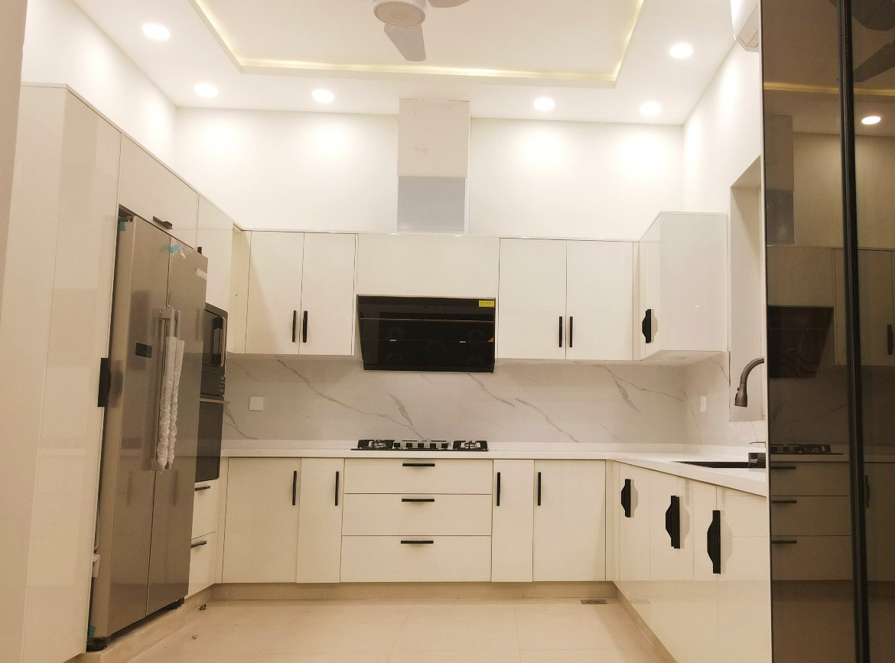
GREASE KITCHEN
Specifications
Size | 16’ x 12’
Door | Solid Wooden
Window | UPVC With Tempered Glass
Floor | Oriel Tiles
Kitchen Appliances | Fotile
Deep Freezer | Dawlance
Kitchen Cabinet | Imported Sheets

Slide 18
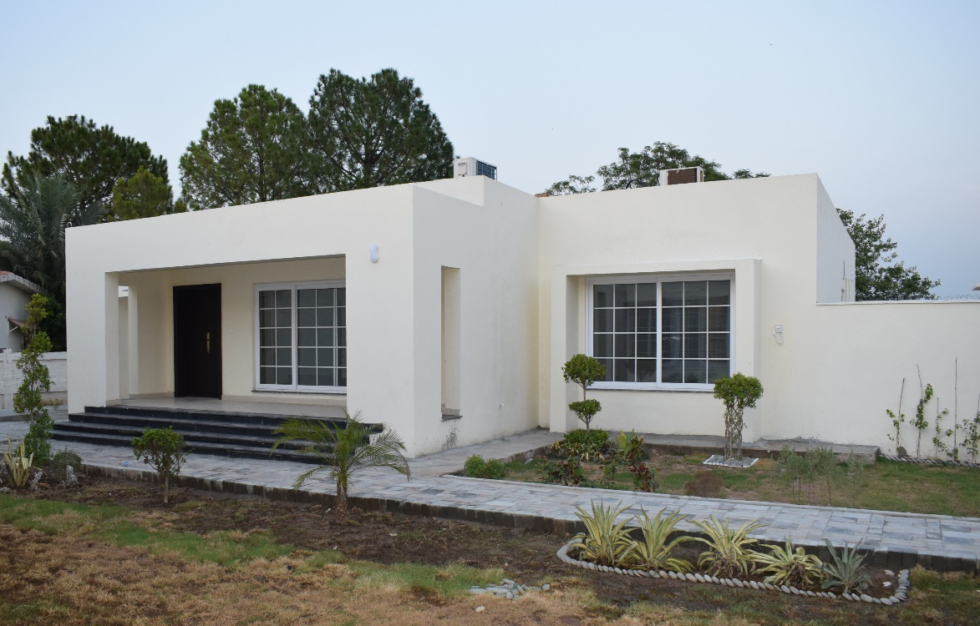
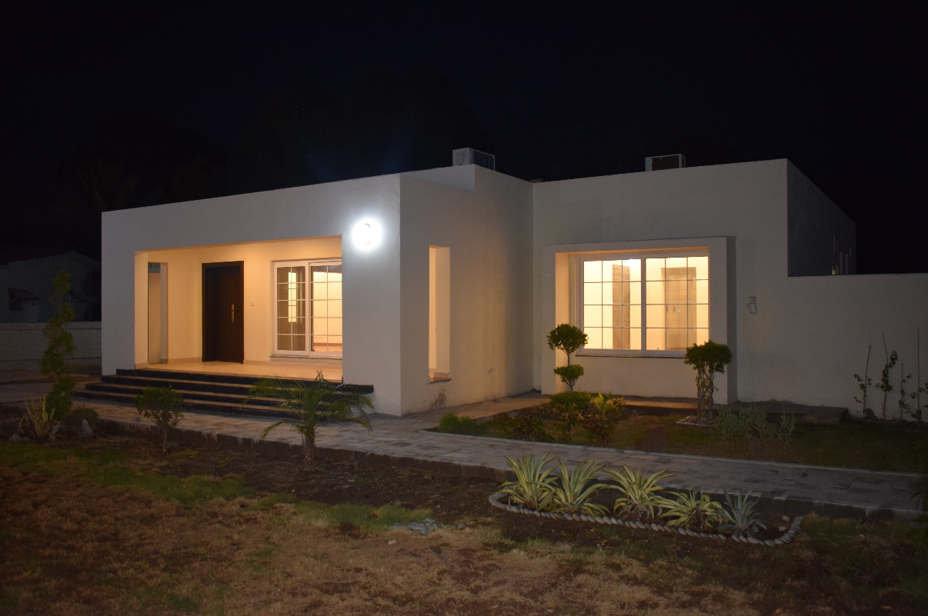
EXTERIOR VIEW

Slide 19
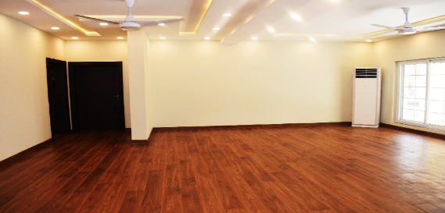
LOUNGE
Specifications
Size | 21-9” x 23’
Door | Solid Wooden
Window | UPVC With Tempered Glass
Floor | Oriel Tiles / wooden
Ceiling | POP
Elec | Gree AC, Lhr Fans, Philips LED Lts

Slide 20
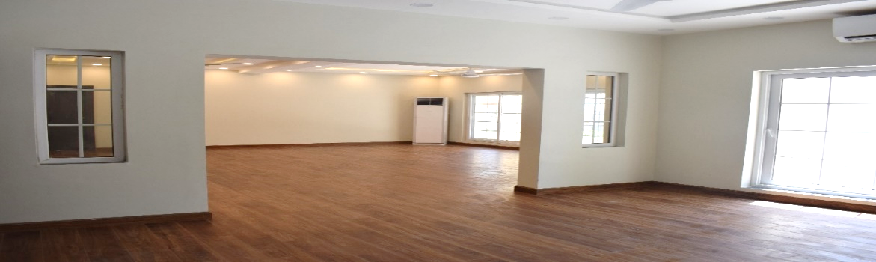
DINNING ROOM
Specifications
Size | 14’ x 16’
Door | Solid Wooden
Window | UPVC With Tempered Glass
Floor | Oriel Tiles / wooden
Ceiling | POP
Elec | Gree AC, Lhr Fans, Philips LED Lts

Slide 21
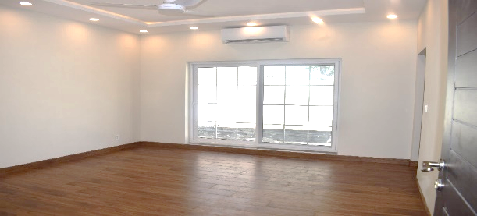
BEDROOM
Specifications
Size | 14’ x 16’
Door | Solid Wooden
Window | UPVC With Tempered Glass
Floor | Oriel Tiles / wooden
Cupboards | Imported Sheets
Ceiling | POP
Elec | Gree AC, Lhr Fans, Philips LED Lts

Slide 22
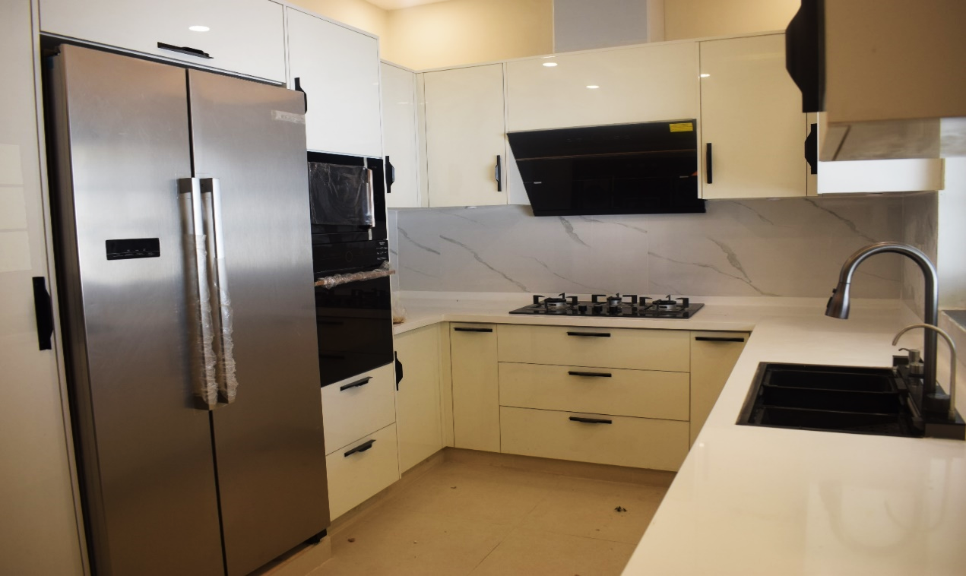
KITCHEN
Specifications
Size | 14’ x 9’
Door | Solid Wooden
Window | UPVC With Tempered Glass
Floor | Oriel Tiles
Kitchen Appliances | Fotile
Kitchen Cabinet | Imported Sheets
Refrigerator | Bosch
Sink | Sigplus

Slide 23
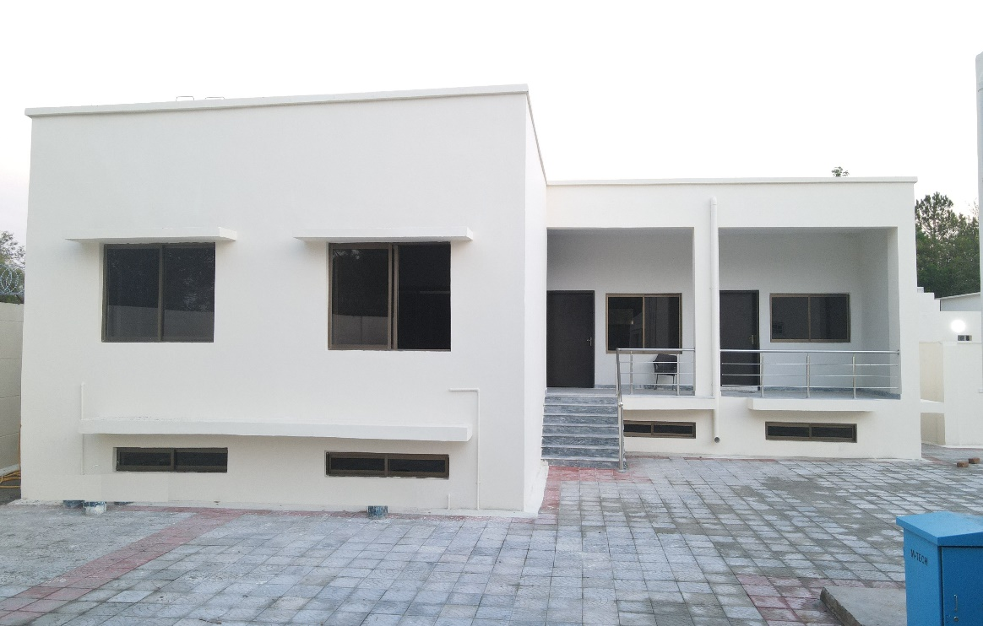
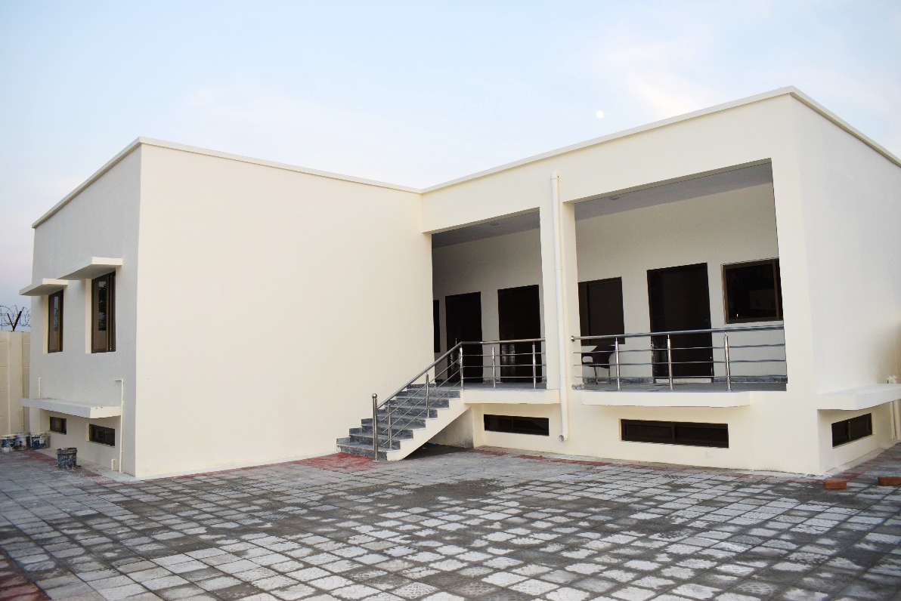
EXTERIOR VIEW

Slide 24
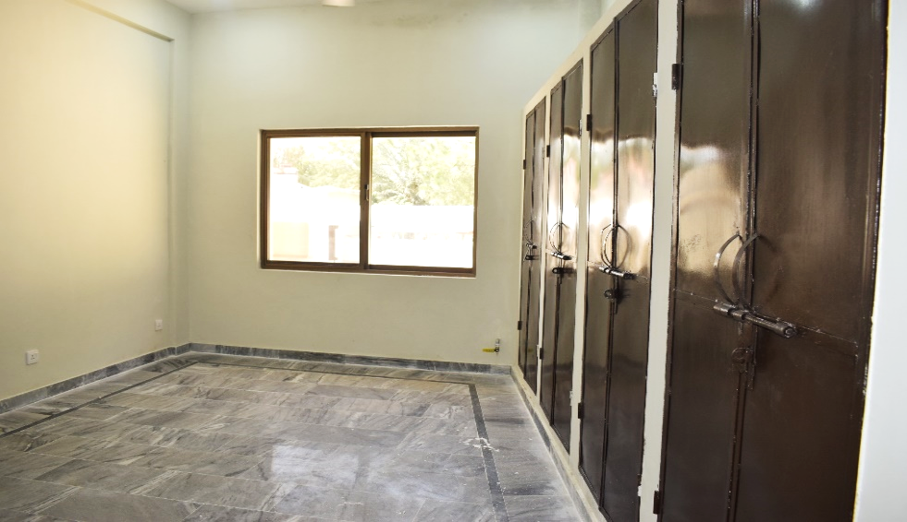
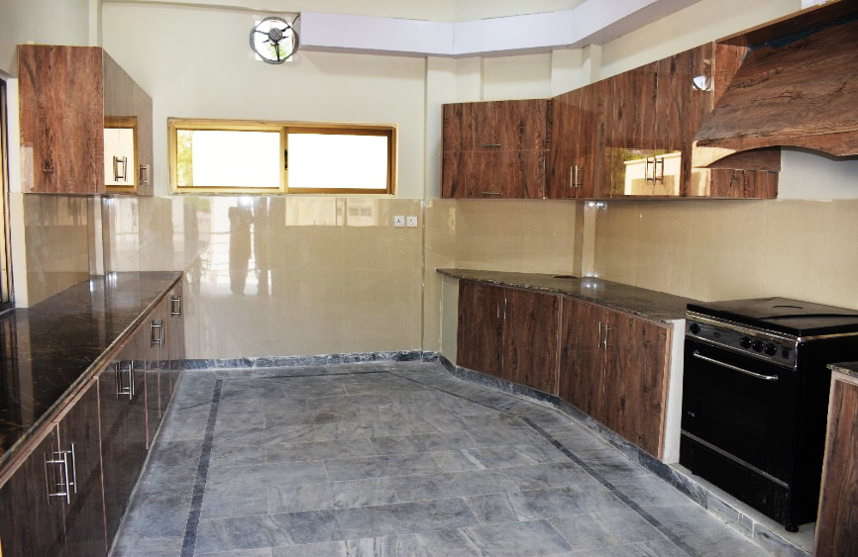
LIVING ROOM/ KITCHEN

Slide 25
INTENT
Const of House 36 A & B was undertaken on the site of Old DG RV&FC House which was dml in Feb 2024 owing to its deteriorated condition and hy maint effort. Purpose made customized designs for both A type houses, annexes and adm area were dev so as to ensure optimum space utilization and adequate circulation area. Adherence to best engg practices, instl of enhanced finishing items and addressing all user reqs were duly ensured during various phs of const

